Slide 1
The Making of a Science Teacher
Paul Adams
Fort Hays State University
21 April 2018
KATS KAMP

Slide 2
Teaching as Science, Art, and Craft
http://www.differencebetween.com/difference-between-science-and-vs-art/

Slide 3
The Science - Strategies and Practices
http://mast.ecu.edu/modules/tmes/concept/

Slide 4
Learning, Learners, and Pedagogy
https://noborderslearning.com/pedagogy/

Slide 5
Knowing what you know . . and knowing what you don’t
https://www.trainsmartinc.com/5-ways-engage-subject-matter-experts/
https://www.pinterest.com/pin/708472585100370296/

Slide 6
Classroom Dynamics
https://umichsoe.digication.com/student_reviewer_sample2/Knowledge_Synthesis_Page_2.1

Slide 7
Inclusion and Culture
https://www.youtube.com/watch?v=_Pa4K2T9OF8

Slide 8
Knowledge of standards
www.nextgenscience.org

Slide 9
PSK -Pedagogical Standards Knowledge (not just PCK anymore)
http://stemoregon.org/oregon-science-project-announces-new-statewide-science-ngss-leadership-opportunity-k-12-educators/

Slide 10
The Science, Art, and Craft of Teaching Science
Source: https://planetparadigm.wordpress.com/2009/01/09/gestalt-switch/

Slide 11
What I have learned…
Source: http://www.sciencecartoonsplus.com/gallery/education/galedd.php#

Slide 12
Develop KSOTO
Larson, G. (2003). The Complete Far Side. Riverside, NJ : Andrews McNeel Publishing

Slide 13
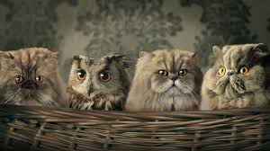
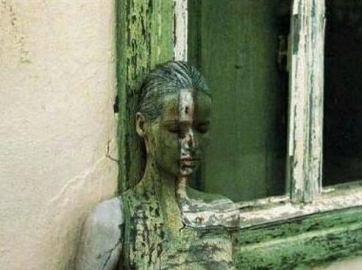
KEEN
SENSE
OF
THE
OBVIOUS
PHENOMENA!
http://screenheaven.com/wallpaper/hiding-in-plain/60374/
https://thelifeididntchoose.files.wordpress.com/2017/11/hiding-in-plain-sight.jpg?w=492

Slide 14
Be a good taker
Larson, G. (2003). The Complete Far Side. Riverside, NJ : Andrews McNeel Publishing

Slide 15
Use the Magic Moment

Slide 16
Practice x Perseverance x Patience P³
Larson, G. (2003). The Complete Far Side. Riverside, NJ : Andrews McNeel Publishing
“Notice all the computations, theoretical scribblings, and lab equipment, Norm . . . Yes, curiosity killed these cats.”

Slide 17
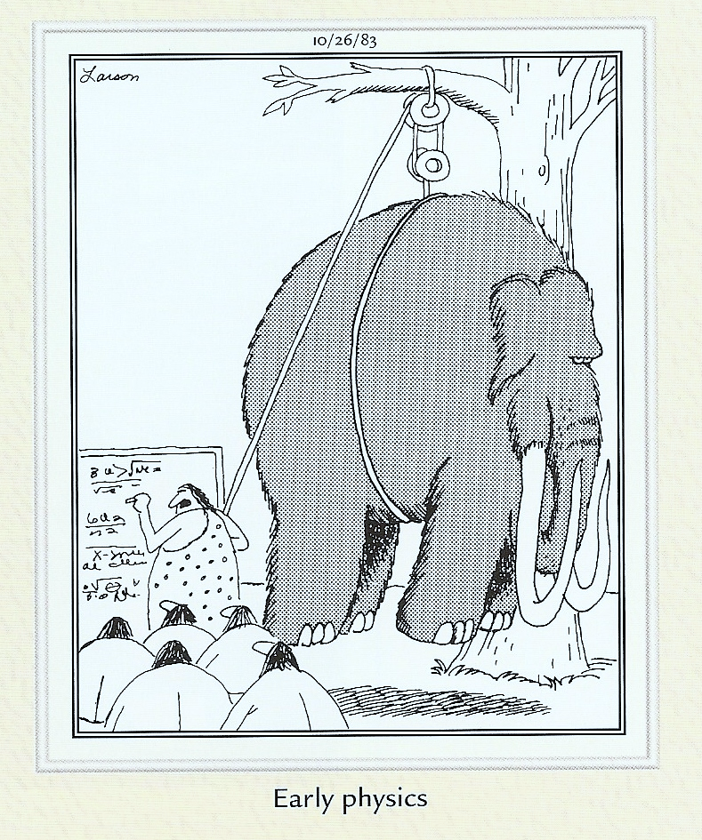
Energy Excitement Enthusiasm E³
Larson, G. (2003). The Complete Far Side. Riverside, NJ : Andrews McNeel Publishing

Slide 18
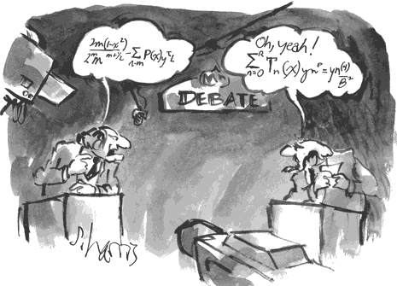
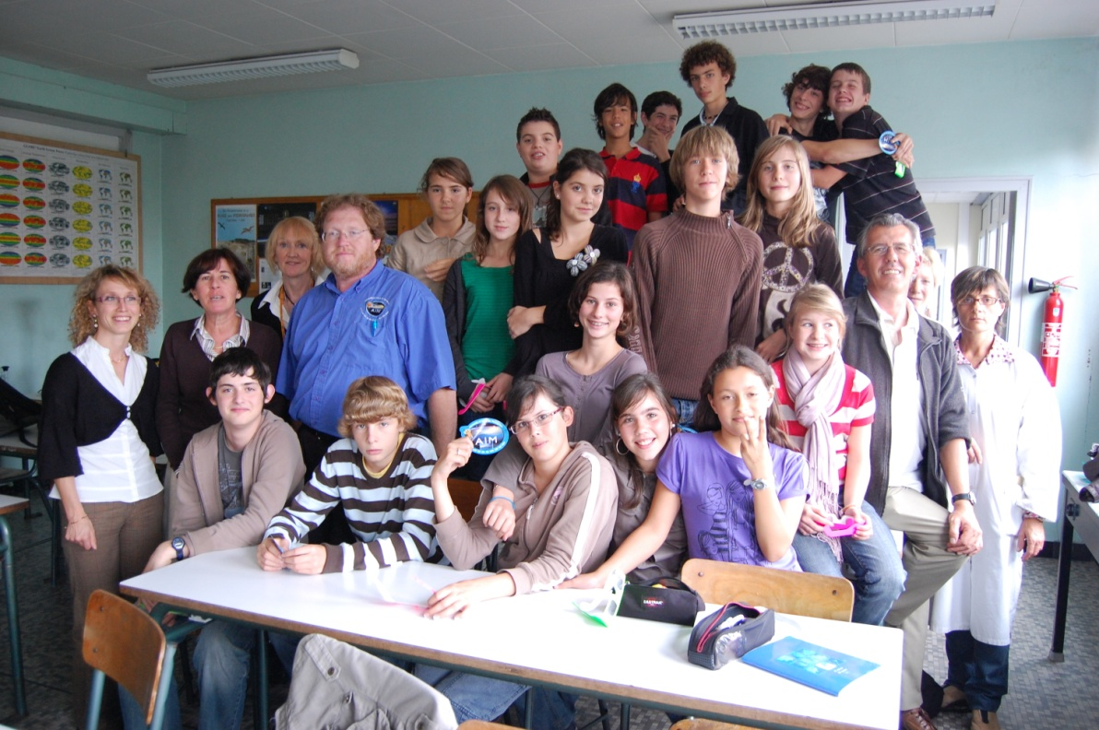
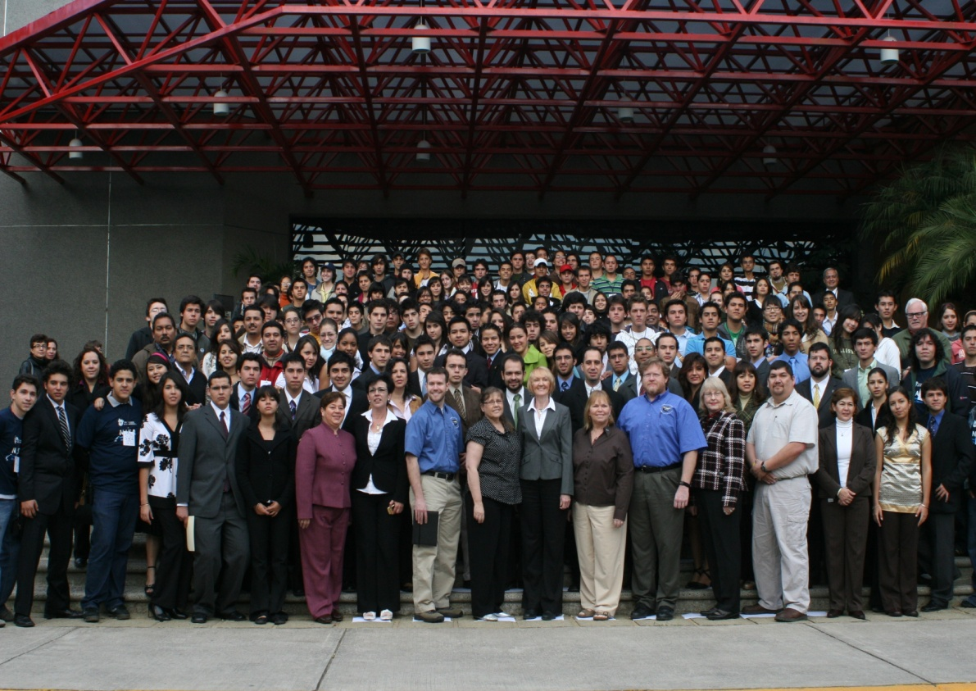
Science is a Language
http://www.sciencecartoonsplus.com/gallery/math/index.php#

Slide 19
Science is a Language
http://www.sciencecartoonsplus.com/gallery/math/index.php#

Slide 20
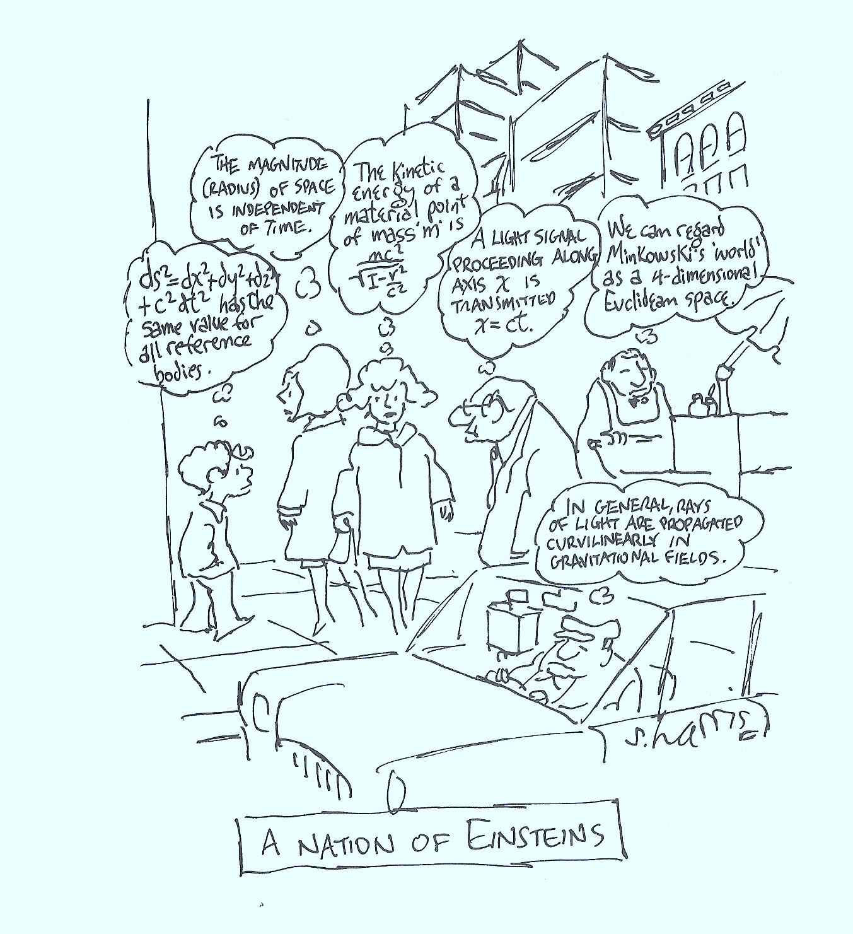
Source: http://www.sciencecartoonsplus.com/gallery/einstein/index.php

